Slide 1
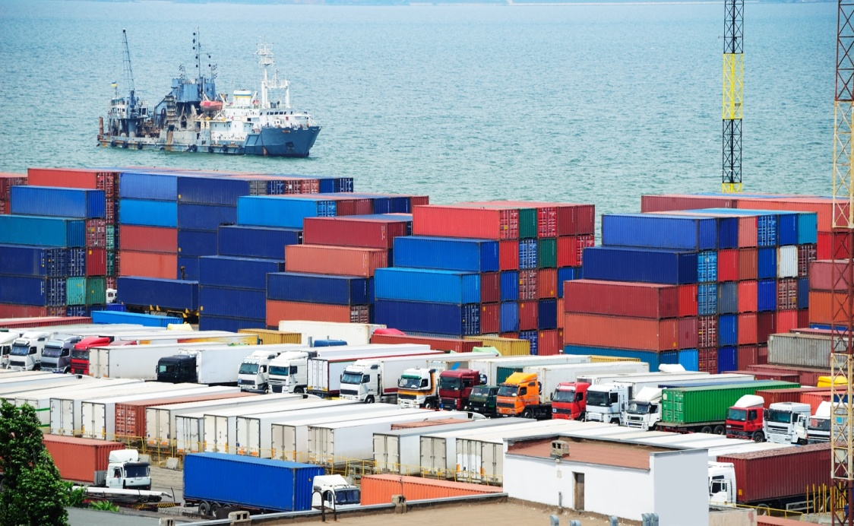
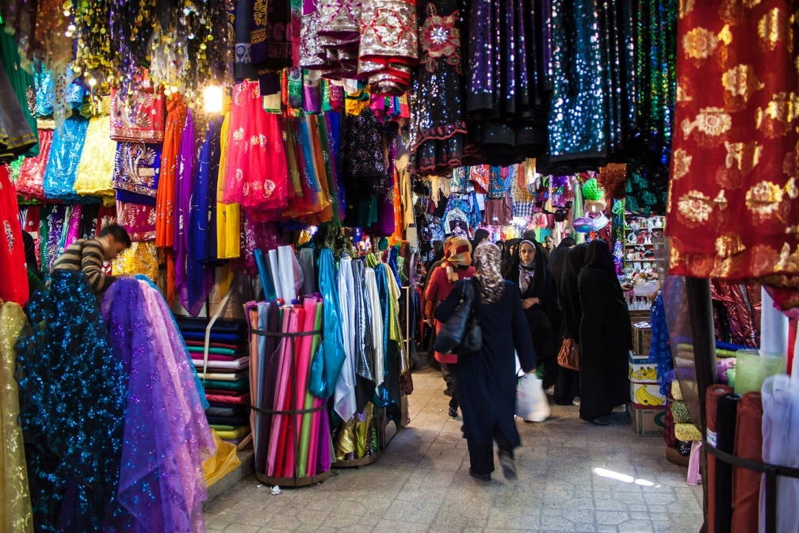
Why do people trade?
© Rob Wilson / Shutterstock.com

Slide 2
Rate the item(s) in your bag on a scale of 1–10; 10 means you are extremely satisfied.
Notes:
Image source: smarterer.com

Slide 3
Total number of trades, Round 2: _____
Number of students who reported a higher value rating after Round 2: ______

Slide 4
Total number of trades, Round 3: _____
Number of students who reported a higher value rating after Round 3: _____

Slide 5
Trade is the voluntary exchange of goods and services among individuals and businesses.

Slide 6
Motive for Trading
People expect to gain by trading with others. They hope to receive a good or service that is more valuable than whatever they trade away.
Motive for Not Trading
People do not trade when the good or service being offered is of less value than the good or service they are asked to exchange.

